Slide 1


IoT Camp preview
Erika Pinna
Microsoft Innovation Center - ISMB
b-erikap@microsoft.com
Gianfranco Caputo
ISMB
caputo@ismb.it
Francesco Scullino
Microsoft Innovation Center - ISMB
v-frscul@microsoft.com

Slide 2
Agenda
BizSpark and IoT Camp introduction
Setup the environment to work with nucleo STM32
Setup the environment to work with Microsoft Azure
Microsoft Azure overview

Slide 3
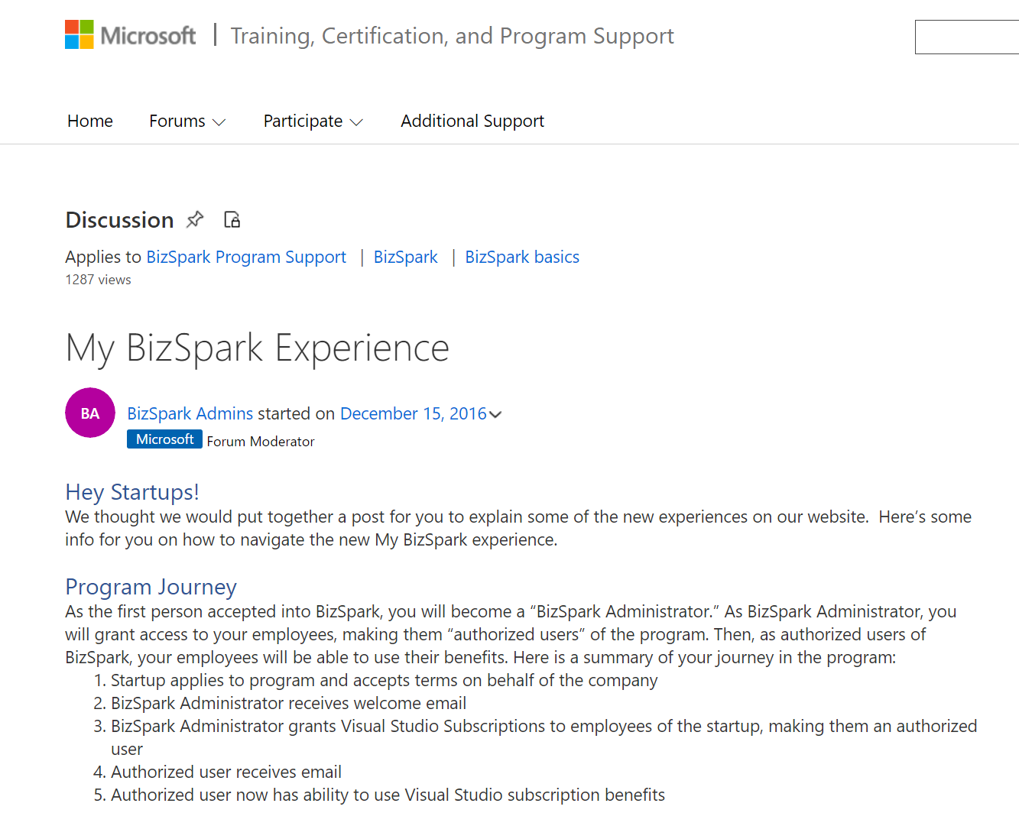
Activate your BizSpark Microsoft Azure subscriptions
https://goo.gl/dD6O4p

Slide 4
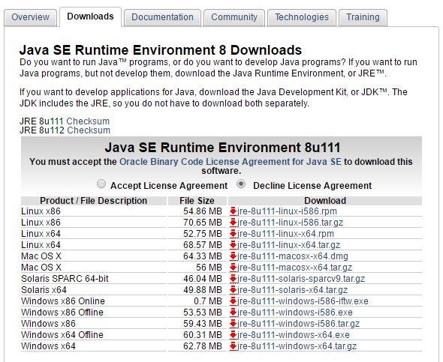
Setup the environment to work with STM32 Nucleo(I)
Download and install Java Runtime Environment http://www.oracle.com/technetwork/java/javase/downloads/index.html

Slide 5
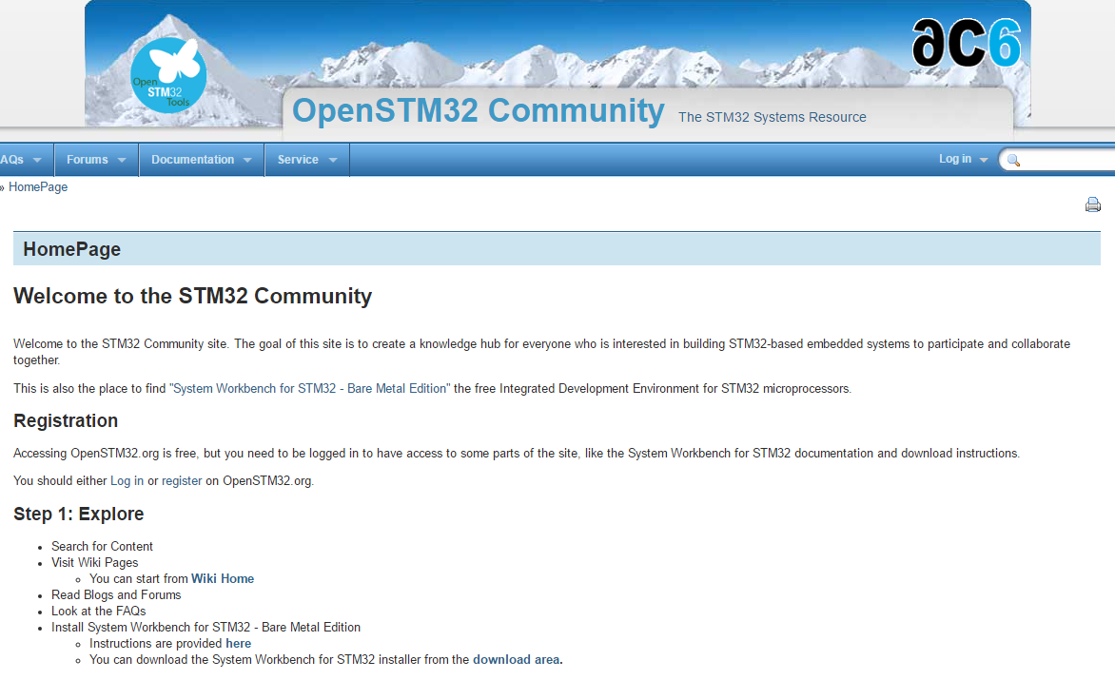
Setup the environment to work with STM32 Nucleo(II)
Download and install System Workbench for STM32 http://www.openstm32.org/HomePage

Slide 6
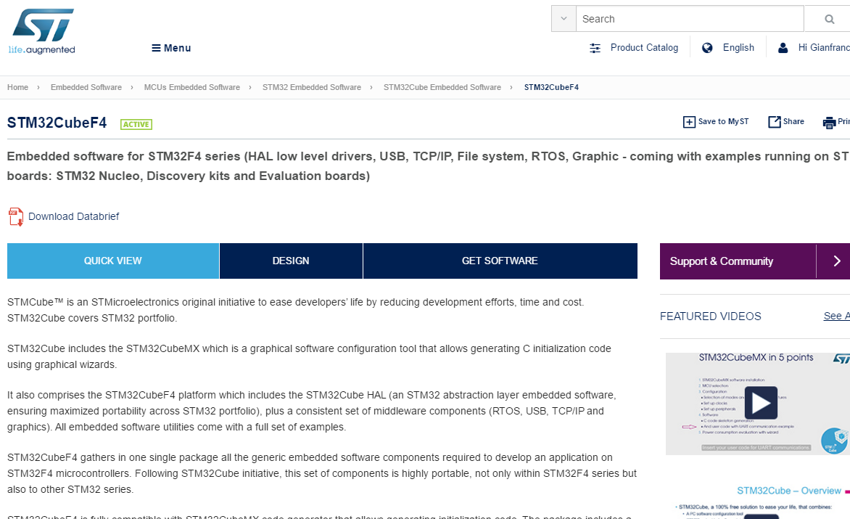
Setup the environment to work with STM32 Nucleo(III)
Download and extract STM32CubeF4 SDK http://www.st.com/en/embedded-software/stm32cubef4.html

Slide 7
Setup the environment to work with STM32 Nucleo(III)
Download the tools without registration

Slide 8
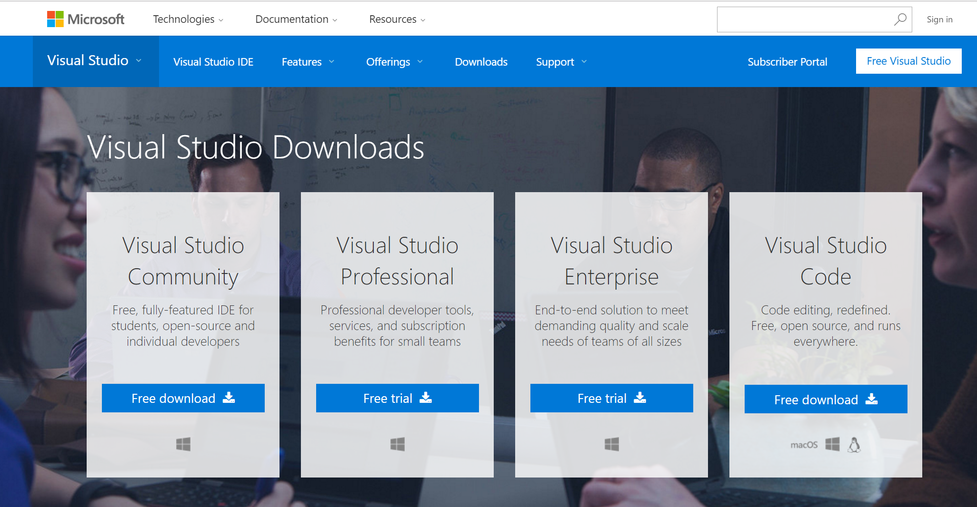
Setup the environment to work with Microsoft Azure (I)
Download and install Visual Studio 2015 https://www.visualstudio.com/downloads/

Slide 9
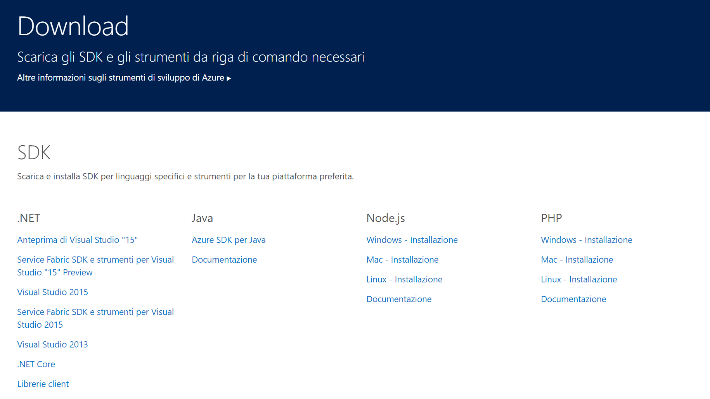
Setup the environment to work with Microsoft Azure (II)
Download and install Microsoft Azure SDK for Visual Studio 2015 https://azure.microsoft.com/it-it/downloads/

Slide 10
Microsoft Azure overview

Slide 11

Microsoft Azure
Comprehensive set of services that enable you to quickly build, deploy and manage applications across a global network of Microsoft-managed datacenters.

Slide 12
On Prem - IaaS – PaaS - SaaS
Hosting models
Business model
On Premises
(Private Datacenter)
Infrastructure
(as a Service)
Platform
(as a Service)
Software
(as a Service)
Applications
Applications
You manage
Applications
Applications
You scale, make resilient and manage
You scale, make
resilient & manage
Data
Data
Data
Data
Runtime
Runtime
Runtime
Runtime
Scale, resilience and management by vendor
Middleware
Middleware
Middleware
Scale, resilience and management by vendor
Middleware
O/S
O/S
O/S
O/S
Virtualization
Virtualization
Managed by vendor
Virtualization
Virtualization
Servers
Servers
Servers
Servers
Storage
Storage
Storage
Storage
Networking
Networking
Networking
Networking
Notes:
Fare esempio di e-Commerce

Slide 13



Microsoft Azure
flexible
open
solid

Slide 14

Microsoft Azure Web Apps

Slide 15
Full capability set available including:
.NET, Node.js, Java, PHP, and Python
WebJobs for long running tasks
Integrated VS publish, remote debug…
CI with GitHub, BitBucket, VSO
Auto-load balance, Autoscale, Geo DR
Virtual networking and hybrid connections
Site slots for staged deployments
Web Apps
Web apps run as-is
no changes required

Slide 16
Demo

Slide 17






Data services
SQL
Database
DocumentDB
Media & CDN
Data
Database as a service
Data
Warehouse
MY APP
SQL/no-SQL data stores
Developer services
Big Data capabilities
Storage
Tables
Integration
Search
Azure
Search
Caching
Data
Identity & security
Redis
Cache
Notes:
Adding Superpowers to your Apps
Once you’ve addressed the question of what is nature of your app, where will it run and what design approach you should take, you have a world of powerful Azure services at your disposal to make your app truly great.
There are more than sixty—and growing—Azure services today that you can use to develop, host, manage, support, secure, integrate, extend, and complement your application development.
Database/Data Services
Integration
Identity & Security
Developer Services
Advanced Analytics and IoT
Media & CDN
The modern developer is a solution composer, combining custom code with the best of finished services to create apps that were unimaginable not so long ago. And delivering those applications at amazing speed.

Slide 18



Developer services
Visual Studio Team Services
Azure
SDK
Team collaboration
Media & CDN
Data
Version Control
MY APP
Dev-Test Labs
Continuous integration and deployment
Integration
Developer services
Dev-Test environments
HockeyApp
Analytics & IoT
Identity & security
Application monitoring and diagnostics
App
Insights
Notes:
Adding Superpowers to your Apps
Once you’ve addressed the question of what is nature of your app, where will it run and what design approach you should take, you have a world of powerful Azure services at your disposal to make your app truly great.
There are more than sixty—and growing—Azure services today that you can use to develop, host, manage, support, secure, integrate, extend, and complement your application development.
Database/Data Services
Integration
Identity & Security
Developer Services
Advanced Analytics and IoT
Media & CDN
The modern developer is a solution composer, combining custom code with the best of finished services to create apps that were unimaginable not so long ago. And delivering those applications at amazing speed.

Slide 19

Identity & security
Azure Active
Directory
Single Sign-on
Access Control
Media & CDN
Data
User Provisioning
MY APP
Groups and distribution lists
Microsoft Graph
Integration
Developer services
Multi-Factor Authentication
Analytics & IoT
Identity & security
Anomalous sign in detection
Notes:
Adding Superpowers to your Apps
Once you’ve addressed the question of what is nature of your app, where will it run and what design approach you should take, you have a world of powerful Azure services at your disposal to make your app truly great.
There are more than sixty—and growing—Azure services today that you can use to develop, host, manage, support, secure, integrate, extend, and complement your application development.
Database/Data Services
Integration
Identity & Security
Developer Services
Advanced Analytics and IoT
Media & CDN
The modern developer is a solution composer, combining custom code with the best of finished services to create apps that were unimaginable not so long ago. And delivering those applications at amazing speed.

Slide 20





Advanced Analytics and IoT
Machine Learning
Stream Analytics
Data Factory
Media & CDN
Data
Machine Learning
Data Lake Store
MY APP
IoT for devices and data collection
Integration
Developer services
Cortana Intelligence Suite
Analytics
Cognitive Services
Cognitive Services
Analytics & IoT
Identity & security
HDInsight
IoT Hub
Notes:
Adding Superpowers to your Apps
Once you’ve addressed the question of what is nature of your app, where will it run and what design approach you should take, you have a world of powerful Azure services at your disposal to make your app truly great.
There are more than sixty—and growing—Azure services today that you can use to develop, host, manage, support, secure, integrate, extend, and complement your application development.
Database/Data Services
Integration
Identity & Security
Developer Services
Advanced Analytics and IoT
Media & CDN
The modern developer is a solution composer, combining custom code with the best of finished services to create apps that were unimaginable not so long ago. And delivering those applications at amazing speed.

Slide 21







Integration services
Logic Apps
API Apps
Media & CDN
Business process workflow
API Management
Data
MY APP
On-Premises/SaaS Connectivity
Service Bus
Integration
Developer services
Messaging
Biztalk Services
API Management
Analytics & IoT
Identity & security
Hybrid Connections
Queues
Notes:
Adding Superpowers to your Apps
Once you’ve addressed the question of what is nature of your app, where will it run and what design approach you should take, you have a world of powerful Azure services at your disposal to make your app truly great.
There are more than sixty—and growing—Azure services today that you can use to develop, host, manage, support, secure, integrate, extend, and complement your application development.
Database/Data Services
Integration
Identity & Security
Developer Services
Advanced Analytics and IoT
Media & CDN
The modern developer is a solution composer, combining custom code with the best of finished services to create apps that were unimaginable not so long ago. And delivering those applications at amazing speed.

Slide 22


Media services and content delivery network
Encoding
Indexing
Business/enterprise video
Media & CDN
Data
Content Protection
MY APP
Broadcasting
Media Player
Integration
Developer services
Media streaming
Media Analytics
Media analytics
Analytics & IoT
Identity & security
CDN from Akamai
Global content delivery
CDN from Verizon
Notes:
Adding Superpowers to your Apps
Once you’ve addressed the question of what is nature of your app, where will it run and what design approach you should take, you have a world of powerful Azure services at your disposal to make your app truly great.
There are more than sixty—and growing—Azure services today that you can use to develop, host, manage, support, secure, integrate, extend, and complement your application development.
Database/Data Services
Integration
Identity & Security
Developer Services
Advanced Analytics and IoT
Media & CDN
The modern developer is a solution composer, combining custom code with the best of finished services to create apps that were unimaginable not so long ago. And delivering those applications at amazing speed.

Slide 23
Q & A

Slide 24
Keep in touch bizitbus@microsoft.com

